Slide 1
Capacities and Flexibilities
CMS Waivers in Times of National Emergency

Slide 2

Notes:
I’m sure you all know what this is. This is the CDC’s artistic rendition of the coronoavirus. This virus has affected all of our lives and I do not doubt that we have given it plenty of thought over the past days to weeks.

Slide 3
Are Hospitals Near Me Ready for Coronavirus?
Notes:
But, how many of you have asked yourself this question? Or asked this question about your friends and family across the country?

Slide 4
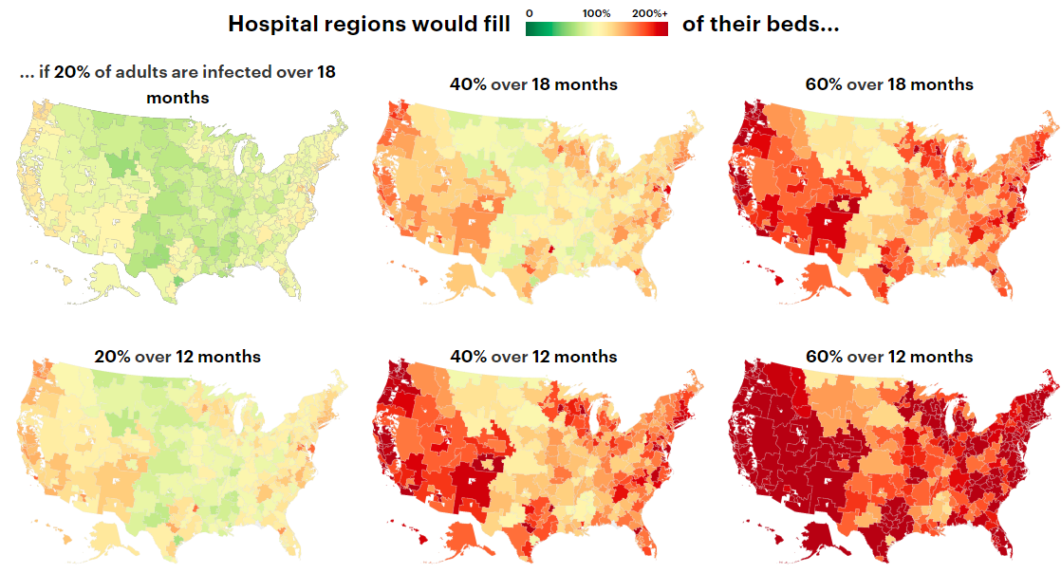
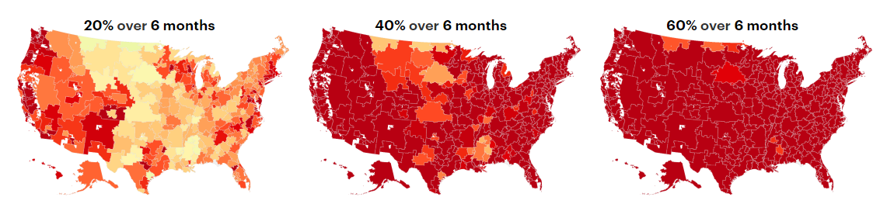
Source: Harvard Global Health Institute, Hospital Bed Capacity & COVID Estimates
Notes:
A study out of Harvard sought to answer that very question. Very quickly, this heat map shows hospital capacity (beds). Each column represents the percentage of adults infected with COVID-19 and each row represents the timeframe for that level of infection. Note, green is under 100% hospital capacity, yellow is near 100% capacity, and red is well OVER 100% capacity, nearing 150-200% capacity. *Germany expects 70%
A policy-maker might see this graph and think “stopping the spread” and/or increasing the number of hospital beds may be the only options…However, a potential compliment must also be explored, in fact is being explored, a policy which could both increase hospital capacity and provide flexibility at the health system level during this time of crisis. I am talking about the Section 1135 CMS Waiver.

Slide 5
The U.S. Constitution does not grant any explicit power to the President in times of Emergency.
Article 1, Section 8
Executive orders and proclamations in times of war and peace
Suspension of Habeas Corpus (Lincoln 1861)
Relocating Japanese Americans to Inland Interment Camps (Roosevelt 1942)
Nationalizing steel-mills during Korean War (Truman 1950)
Notes:
Just like “health”, the term “emergency” does not appear in the U.S. constitution. But, to defend against enemies both foreign and domestic, a strong military must be created, maintained, and utilized when called upon to enter war (Article 1, sec 8 a,b,c). These powers, however, are not allocated to the President, but to Congress (Legislative branch). Recent constitutional law scholars believed, however, that the Framers were conflicted, not wanting to give too much broad, dictatorial power to the executive, it was also known that the executive branch would be most equipped to act promptly in response to war-time emergencies. The staying power of the constitution is that it does not need to be revoked in times of emergency, rather the interpretation of its broadness can, and has shifted.
With the power to declare executive orders, there were many circumstances where the President effectively declared an emergency as a means to justify further executive action.

Slide 6
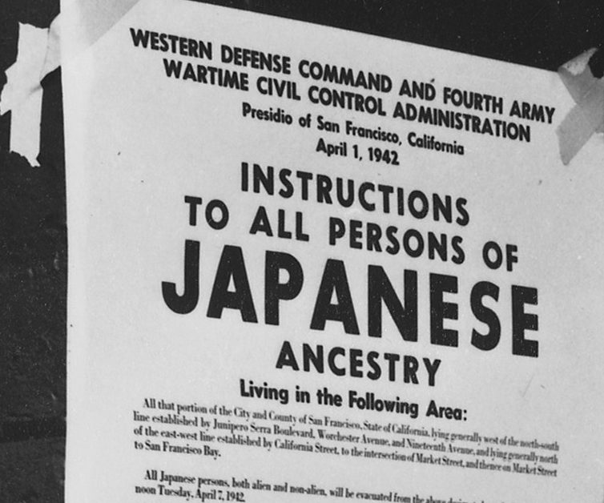
Given the lack of clearly defined power, the Judiciary had power to mitigate threats of overreach
Ex Parte Merryman
Korematsu v. The United States
Young v. The United States
Notes:
Naturally, the supreme court often became involved in these so-proclaimed emergencies. The Supreme Court has permitted the continued use of Executive Orders as a tool for exercising the powers of the Executive Office, as long as these orders were deemed constitutional. Emergency proclamations were no exception (except in the case of Lincoln, where he ignored a federal district court order and proceeded to suspend Habeas corpus)
FDR also was allowed to proceed with his internment of Japanese-Americans, not because he had the power to do so, but because Congress had established War with Japan and thus granted emergency authority the commander-in-chief, the Supreme Court found that FDR was simply exercising powers of his office.
However, in Young v. USA, the supreme court found that despite an active war the president had no authority to establish an emergency (or seize private property).

Slide 7
Congress has delegated authority and empowered the President to act in times of emergency
The National Emergency Act 1976 (50 U.S.C. §§ 1601-51)
Robert T. Stafford Disaster Relief and Emergency Assistance Act of 1988 (42 U.S.C. §§ 5121-5207)
The Public Health Services Act of 1944 (42 U.S.C. ch. 6A § 201)
42 U.S. Code § 247d.Public Health Emergencies
Notes:
*NE Act: Sections 2 and 3 explicitly delegate authority to declare a national emergency and prescribe powers of the President during such times.
*Stafford Act: further empowers president by differentiating between national emergency and national disaster…however The Stafford Act must first be requested by a governor.
*PHS Act: along with creating and organizing the health governance structure as we know it today, the PHE section allows the Sect. of HHS to declare a public health emergency.
*Trump examples: declare national emergency and declared national disaster (military industry powers to increase capacity)….HHS declared PHE and invoked waiver, Verma providing guidance to CMS (letters to Medicaid directors, toolkits, press release/conf).

Slide 8

President declares National Emergency
HHS Secretary declares Public Health Emergency
Section 1135 Waiver
Notes:
Written into the Medicare and Medicaid legislation, Section 1135 of the Social Security Act permits the Secretary of Health and Human Services to wave certain CMS requirements in times of emergency.
42 U.S.C. § 1320b-5

Slide 9
1115 Waivers
1135 Waivers
“Experiment” focus
Budget Neutrality Requirement
HHS Secretary can create a “blanket” waiver.
Report to congress after emergency
Report to congress after completion of demonstration
Medicare Waivers
Retroactive waiver option
Only covers region in designated emergency area
Proposed by providers, hospitals, health systems, local health departments
Proposed by states
Medicaid Waivers
Notes:
1115: Purpose to assist in case of any experimental, pilot, or demonstration project promoting the objectives of title I, X, XIV, XVI, or XIX, or part A or D of title IV, in a State or States
*Medicare waiver authorized
1135: The purpose is to enable the Secretary to ensure to the maximum extent feasible, in any emergency area and during an emergency period…that sufficient health care items and services are available to meet the needs of individuals in such area enrolled in the programs under titles XVIII, XIX, and XXI and that health care providers that furnish such items and services in good faith, but that are unable to comply with one or more requirements, may be reimbursed for such items and services and exempted from sanctions for such noncompliance.
After beginning my research I overcame another emergency waiver, the 1915(c) K appendix authority…which allows states to amend current HCBS waivers during an emergency situation (less restrictive than a 1135, faster than a 1115 or starting a new 1915(c)…..scope of waiver is very focused

Slide 10
Preliminary Questions
Question 1: What does a 1135 Waiver waive?
Question 2: Are 1135 and 1115 Waivers substitutes or compliments?
Question 3: Do 1135 Waivers vary over time, by geography, and by disaster?

Slide 11
CMS Flexibilities Authorized After Hurricane Katrina
Section 1135 Flexibilities | Section 1115 Flexibilities
EMTALA | Expedite Enrollment
Provider Licensure | Expand Enrollment
Pre-Authorizations and Certifications | Exempt Cost-Sharing*
Payments to Out-of-Network Providers (Medicare Advantage) | Require Cost-Sharing*
HIPPA | Fund an Uncompensated Care Pool
Notes:
Main takeaways: 1135 primarily relaxes administrative barriers and allows for increased provider capacity where 1115 focused on beneficiary coverage and costs.
Following HK, 5 states attempted to pass legislation related to their Medicaid program (including Iowa).

Slide 12
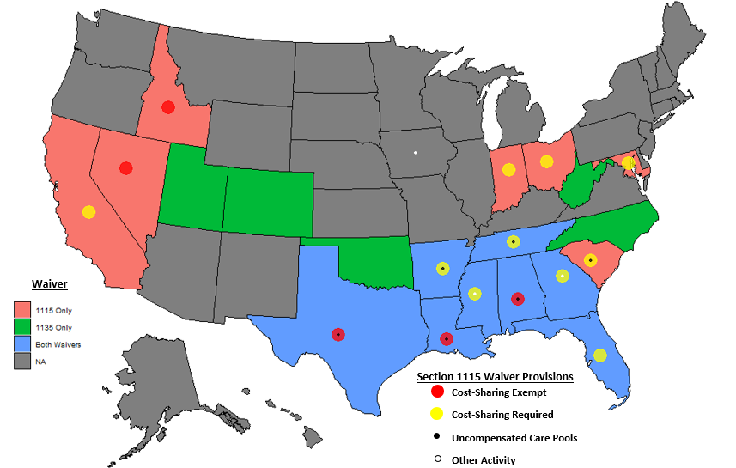
Gulf states with the greatest impact from Katrina initiated both waivers, as they are provide distinct and complimentary flexibilities.
Notes:
13 states passed Section 1135 Waiver
17 states passed Section 1115 Waiver
(8 passed both)

Slide 13
New Orleans Reg'l Physician Hosp. Org., Inc. v. United States, 122 Fed. Cl. 807 (2015)
A pending case where a Medicare Advantage Provider is seeking reimbursement for care received by evacuees, but the defendant claims the waiver limits their contractual obligations.
Notes:
*Katrina example: 1135 waiver →
PHN had 70% market share of all NO Medicare Advantage beneficiaries.
When most of these people left, they were allowed to seek care outside of network. PHN claims US offered reliances of maintaining contractual obligations (capitated payments).
However, US invoked (blanket) 1135 waiver which allowed patients to seek out-of-network care without extra cost and, subsequently
*no decision on case. CMS required to follow through and provide requested documentation.
New Orleans Regional Physician Hospital Organization was a Medicare Advantage provider, whose clients relocated after Hurricane Katrina
Defendant claims a (blanket) Section 1135 Waiver:
allowed patients to seek out-of-network care in times of emergency
Limited contractual obligations (capitated payments) to plaintiff.
Plaintiff claims CMS gave assurances of fulfilling contractual obligation

Slide 14
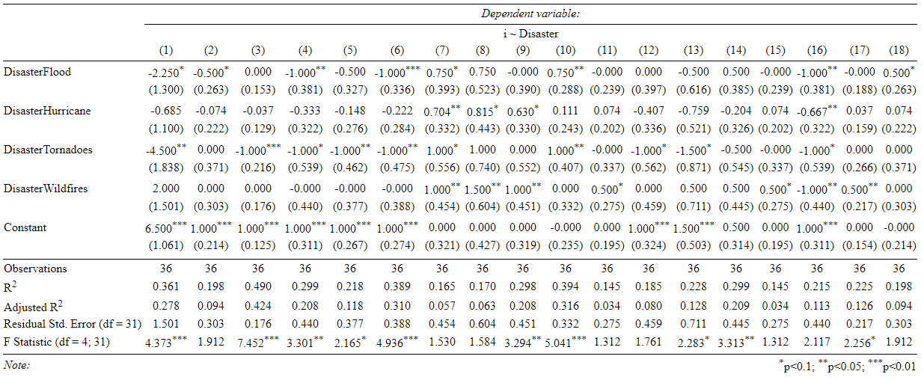
Special 1135 Requests Vary Significantly by Disaster: Appeal Extensions, LOS Calculations, Extending LTC Coverage, and Relaxing Current Waivers
Notes:
Linear and Linear Probability Models
Low-N, but nice preliminary model to begin formulating more rigorous tests (incl. logistic regressions)

Slide 15
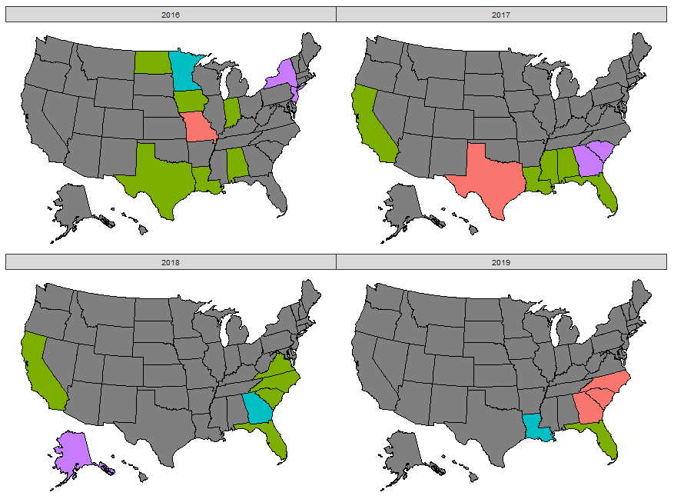

Section 1135 Waiver Requests vary by state and over time
Notes:
SC (Hurricane), NJ (Hurricane), ND and MN (Floods) only states to explicit request expansion of hospital capacity.
Figure 2 shows the variation of Section 1135 Waiver Authority by state for years 2008-2019. For the purposes of figure 2, all waiver requests between 2008-2016 were grouped together. A “Blanket Only” category indictes the state did not submit any special request and only received the standard blanket authority. Administrative special requests included changes to Length of Stay Calculations, Extensions for Appeals, and Rural Designation Definitions. Reimbursement special requests included permissions to receive payment for evacuees, extending coverage for Long-Term Care patients, temporarily altering the state’s reimbursement scheme, and relaxing an existing state Medicaid Waiver.

Slide 16
Aim 1: Evaluate Section 1135 Research and Activity
Objective 2: Analyze the influence of Section 1135 Waivers on Americans’ “Right to Health”.
Objective 3: Design a model incorporating Section 1135 Waivers into the Federalist System.
Obj1: Present Section 1135 Waiver Activity
Data: Agency documents; CMS correspondence; CRS Reports; Federal Registries Methods: Policy scan via Lexis Advance, PubMed, and Agency Websites Results:
Section 1135 Waiver is a compliment to Section 1115 Waivers in times of disaster (Hurricane Katrina map / table)
Section 1135 Waiver activity varies by disaster, state, and over time.

Slide 17
State Response to COVID-19 Florida Governor Requested 1135 Waiver
→ Fast-track provider enrollment to care for Medicare/Medicaid patients → Waive or modify pre-authorization requirements → Waive pre-admission screening → Permits reimbursement for potential evacuation of LTCH
34 States have an approved 1135 Waiver
Notes:
(13) 3/24/20
(34) 3/27/20

Slide 18
Proposal
Aim 2: Develop a research methodology to analyze Section 1135 waiver variation.
H1: This variation can be explained by institutional/political/environmental/economic factors.
*Utilize 2008-2019 datasets
*Create 2020 COVID dataset (states, localities, provider associations)
H2: The variation in Section 1135 waiver activity is associated with variation in outcomes.
*Ideal setup for discontinuity designs

